Slide 1
High School Life in NYC: A Guide to Applying
Gregory Shif and Luka Abjandadze

Slide 2
Introduction
Welcome to high school life in NYC! Get ready for an exciting journey in the Big Apple. Let's explore what makes it special and how you can apply to be a part of it.

Slide 3
Diversity
Experience the richness of diversity in NYC high schools. You'll meet students from all corners of the globe, speaking different languages, and bringing unique perspectives to the table. Whether you're from China, Mexico, Georgia, or anywhere else, you'll find a welcoming community that celebrates cultural differences. Embrace the opportunity to learn from your peers, broaden your horizons, and forge lifelong friendships with people from diverse backgrounds.

Slide 4
Academics
Discover the academic excellence that NYC high schools offer. With a focus on preparing you for college and beyond, these schools provide rigorous coursework and challenging academic programs. Whether you're passionate about science, mathematics, humanities, or the arts, there's a school and a program that will nurture your interests and help you reach your full potential. From advanced placement courses to specialized academies, you'll have access to a wide range of educational opportunities designed to ignite your curiosity and foster intellectual growth.

Slide 5
Extracurricular Activities
Dive into the vibrant world of extracurricular activities in NYC high schools. Beyond academics, these schools offer a plethora of opportunities to explore your interests, develop your talents, and make lasting memories. Whether you're into sports, performing arts, community service, or academic clubs, there's something for everyone. Join a sports team to compete and stay active, audition for the school play to showcase your acting skills, volunteer for a local charity to give back to the community, or participate in a debate club to sharpen your critical thinking and public speaking abilities. With so many options available, you'll find endless ways to enrich your high school experience and build skills that will serve you well in the future.

Slide 6
Support Services
Access a wide array of support services to ensure your success in NYC high schools. From academic support to emotional well-being, these schools are committed to providing you with the resources you need to thrive. Guidance counselors are available to help you navigate the academic and social aspects of high school life, offering guidance on course selection, college preparation, and personal development. Additionally, tutoring programs are available to provide extra assistance in subjects where you may need additional support. Mental health services are also readily available to support your emotional well-being and ensure that you have a positive and fulfilling high school experience. Remember, you're not alone—there are people and resources available to help you succeed every step of the way.

Slide 7
Location
Explore the diverse neighborhoods that host NYC high schools. From the bustling streets of Manhattan to the cultural enclaves of Queens, each borough offers a unique setting for your high school experience. Whether you prefer the energy of city life or the tranquility of suburban surroundings, there's a school location that suits your preferences. Discover the rich tapestry of cultures, cuisines, and communities that make each neighborhood special. No matter where you're from or where you live, you'll find a high school in NYC that feels like home.

Slide 8
Who can attend NYC public schools?
All children aged 4 to 21 who live in New York City have the right to attend public school in NYC until they graduate from high school.
All students applying for public school must be admitted immediately and placed in school within 5 school days.
• Students cannot be turned away because of a lack of space.
Students who have had little or no education in the past cannot be turned away.
All students have the right to attend school regardless of their immigration status or the immigration status of their family members.
  School staff are not allowed to ask you about your immigration status.
  Even if a student or his or her parents are undocumented or don’t have social security numbers, the student can still receive all school services, including free lunch, free breakfast, and transportation.

Slide 9
When can new students register for school?
If you are new to NYC, you can register your child in the public school system at any time. You do not have to wait until the start of the new school year or semester.

Slide 10
Where Can I Enroll?
HIGH SCHOOL ENROLLMENT:
To enroll in High School, go to your local Family Welcome Center. If a youth under the age of 18 has a parent or guardian, the parent or guardian must accompany the youth to the Family Welcome Center to enroll in school. If a youth is an emancipated minor or an unaccompanied youth, they do not need to be accompanied by an adult to enroll in school. The DOE also has several alternative programs for older students, including Career and Technical Education programs, high school equivalency diploma programs, and transfer schools.

Slide 11
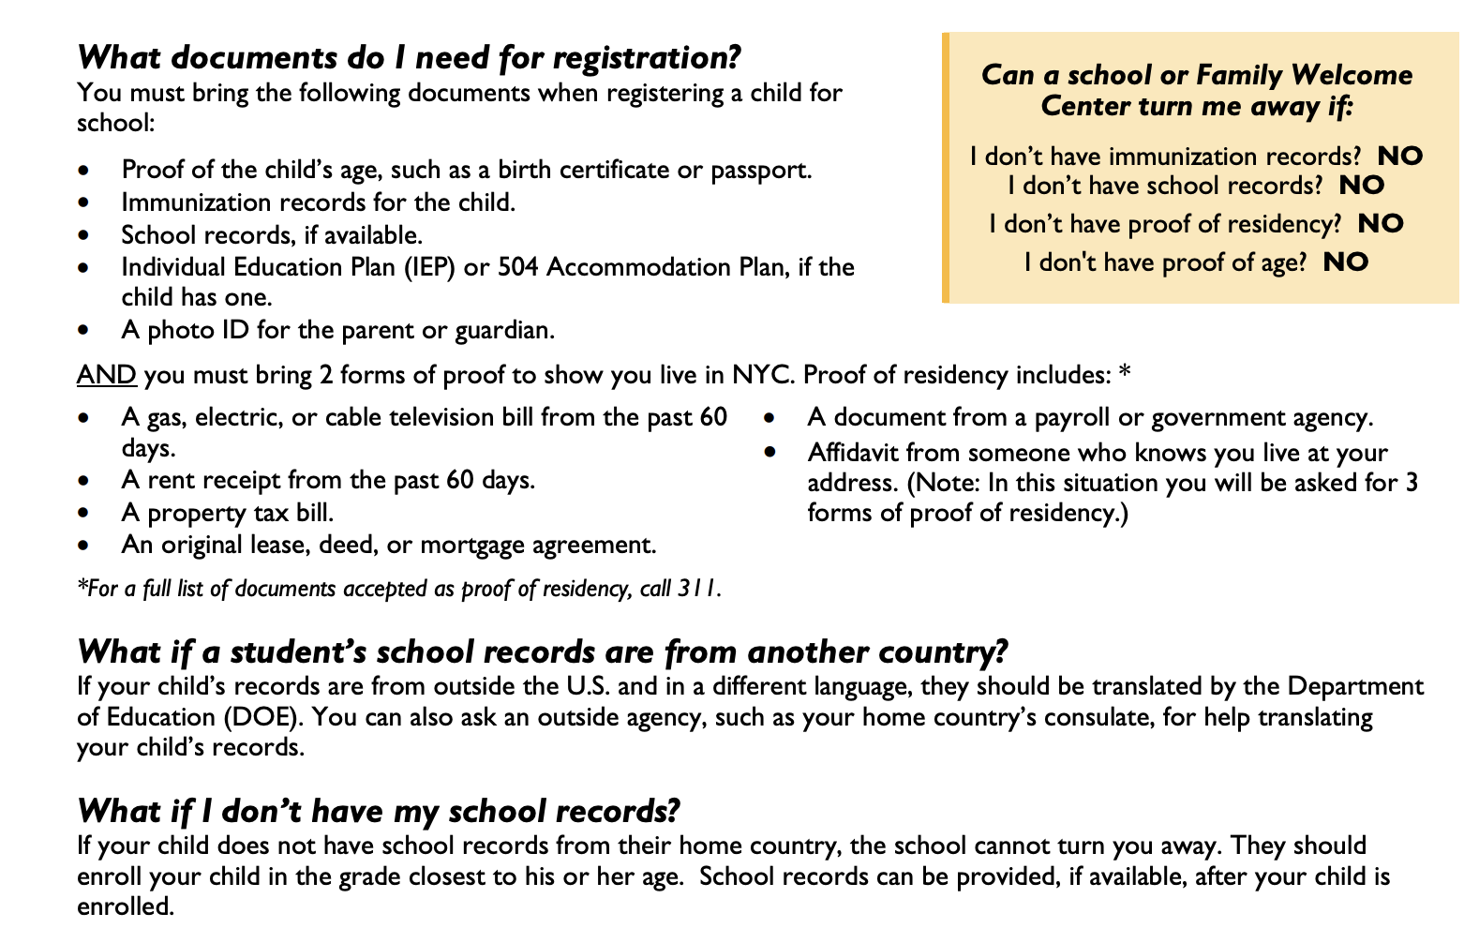

Slide 12
Thank You!

Slide 13
Sources
https://www.advocatesforchildren.org/wp-content/uploads/library/enrollment_for_immigrant_families.pdf

